Slide 1
SRA Small Boat Reservation System
Two ways to use the system
Web site (http://sammamish.bookedscheduler.com)
Chat bot (425-961-6576) ← EASIEST (see examples)
How do I sign in?
User name: firstname.lastname (e.g. dennis.ferrer)
Password: birthday mm.dd.yyyy (e.g. 09.21.1992)
What do I do next?
Reserve a boat
Check in to your reservation when you arrive
Check out when you leave
You can also checkin/checkout on the SRA iPad
Do I need to make a reservation in advance?
NO – you can just tell the bot what boat you’re rowing and for how long – “taking out the shaffer for 2 hours”
You do still need to check out when you leave
What about private boat owners?
The process is the same – for safety and security
The bot doesn’t understand me!
You can always type “?” to see what you can say

Slide 2
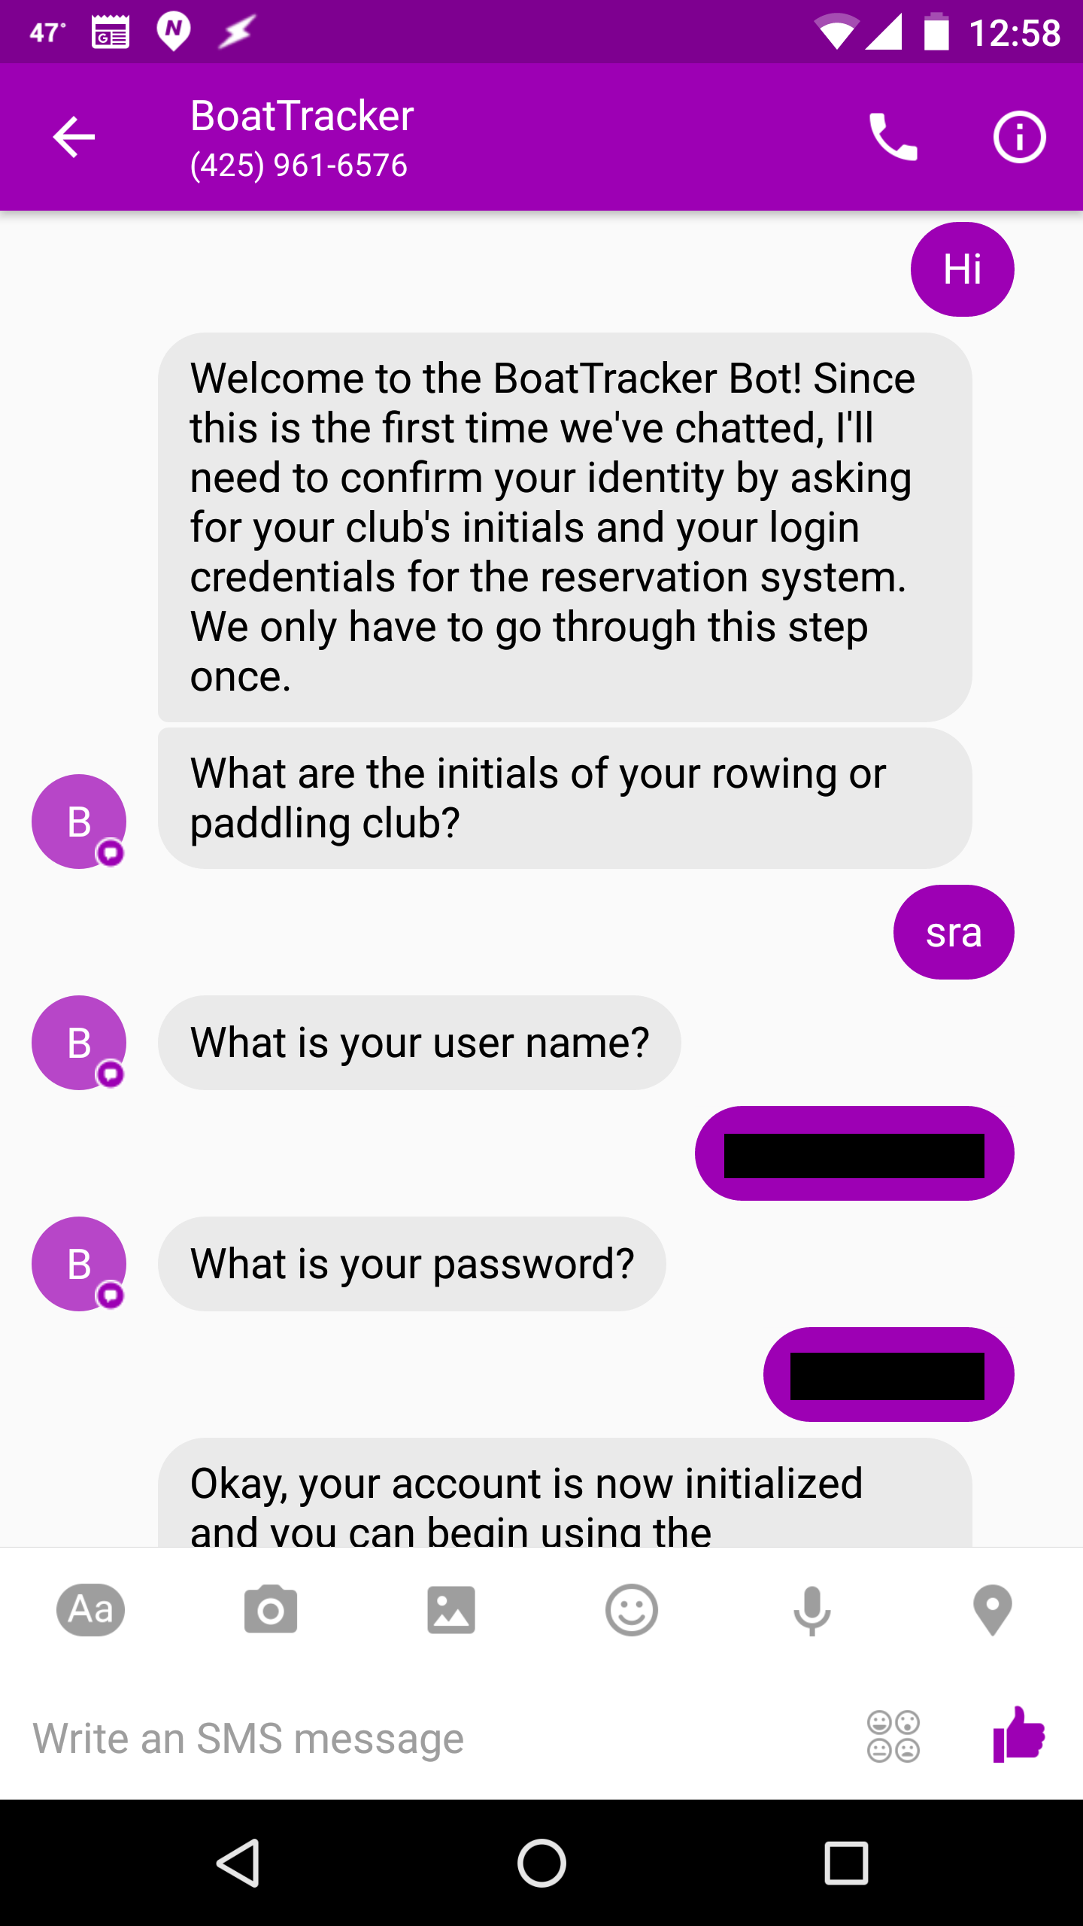
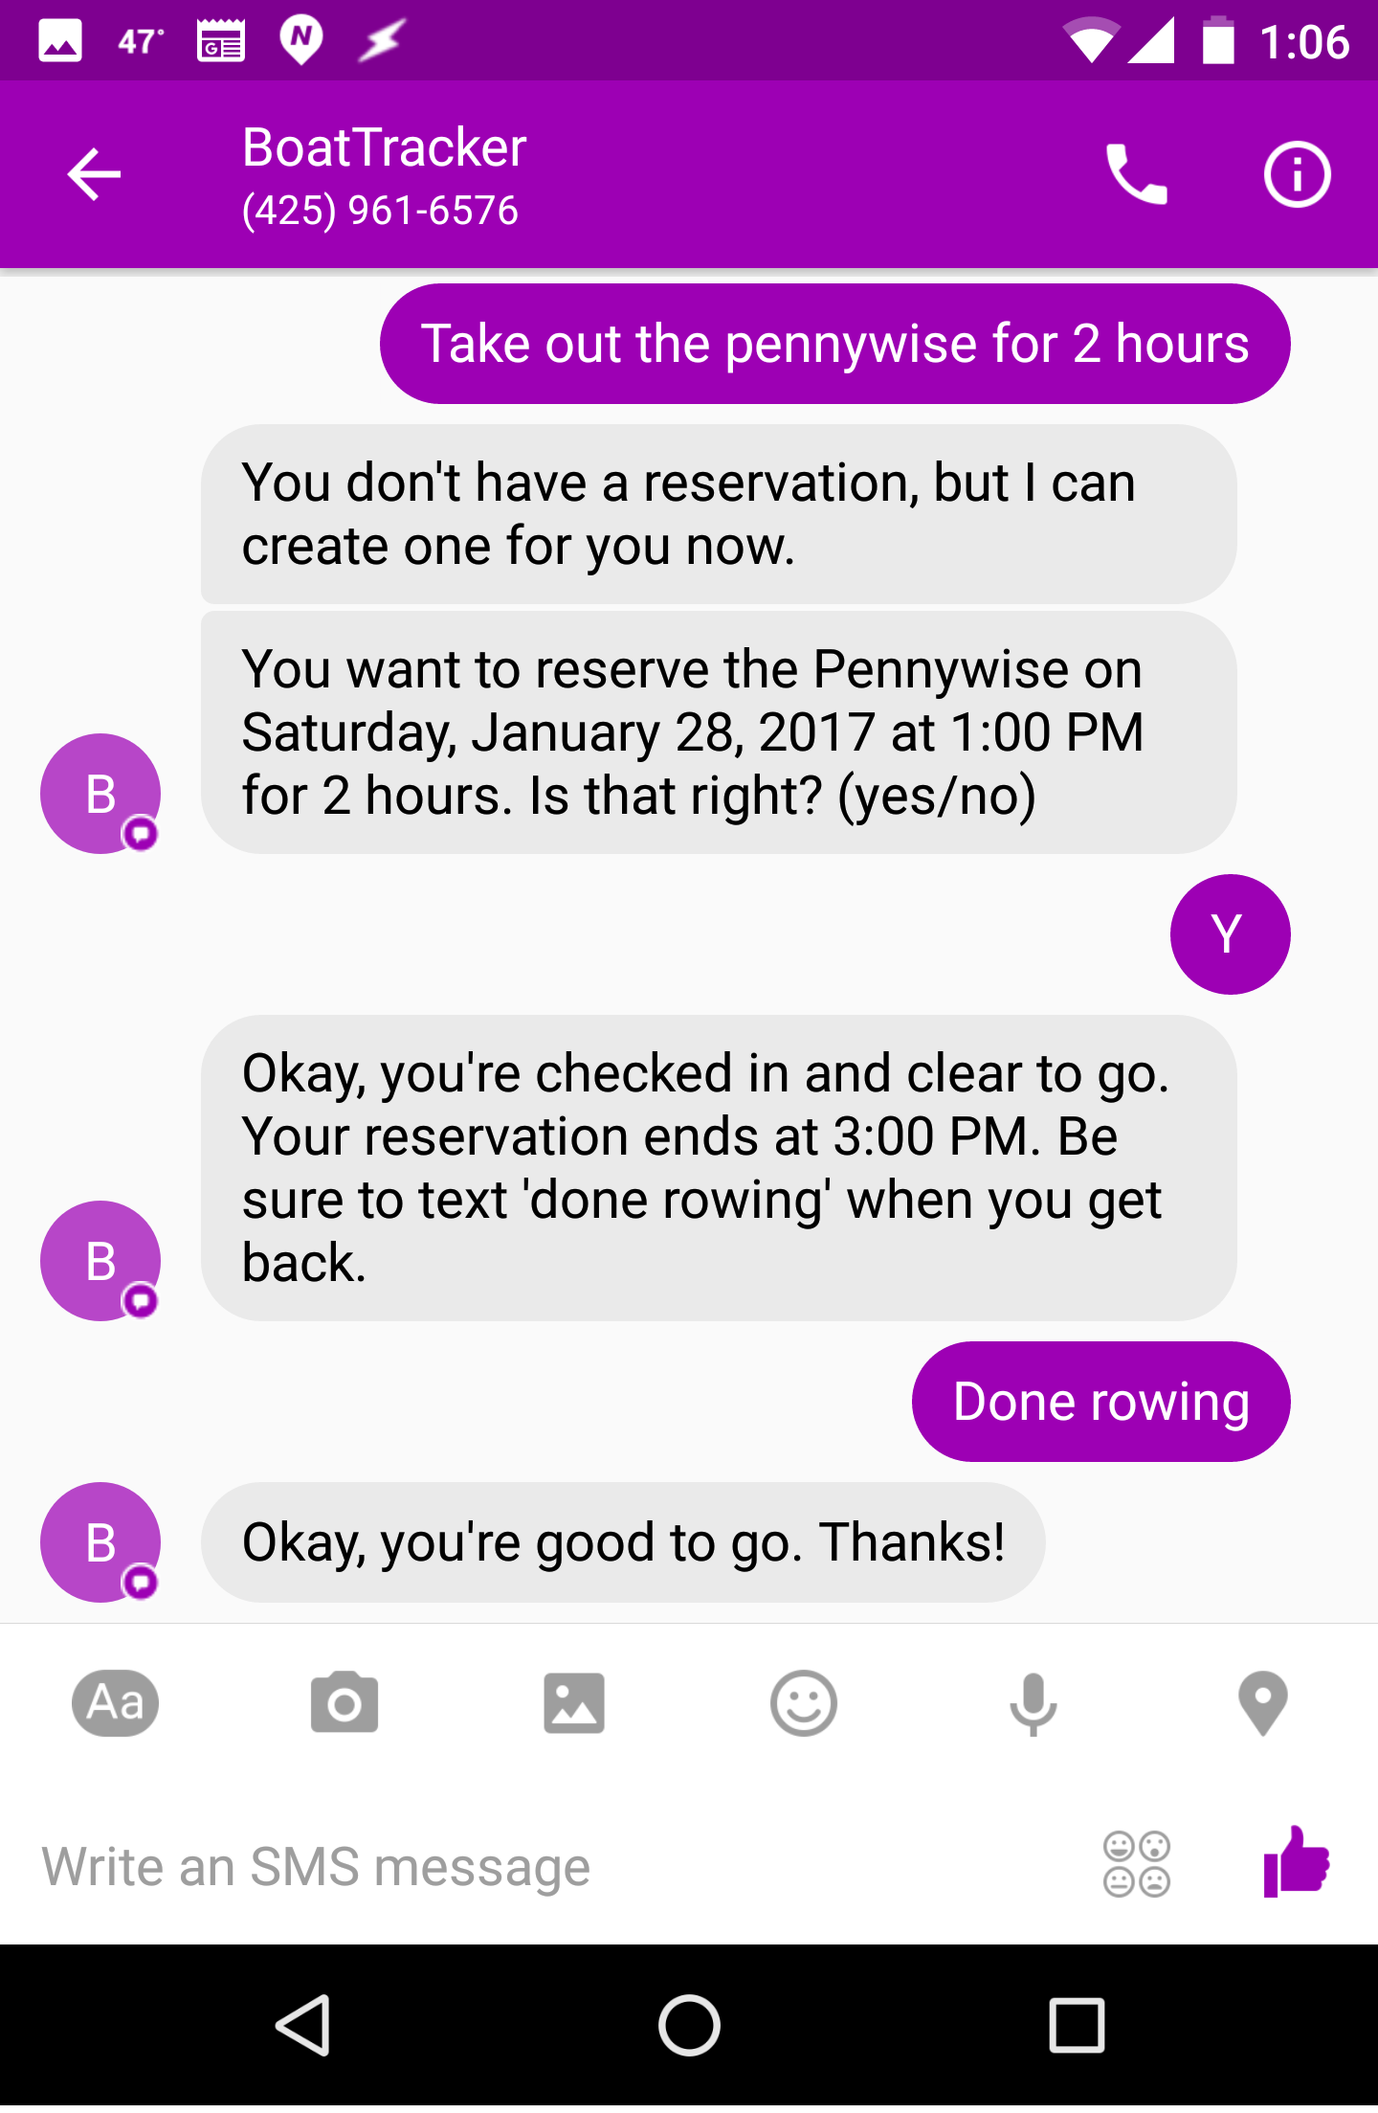
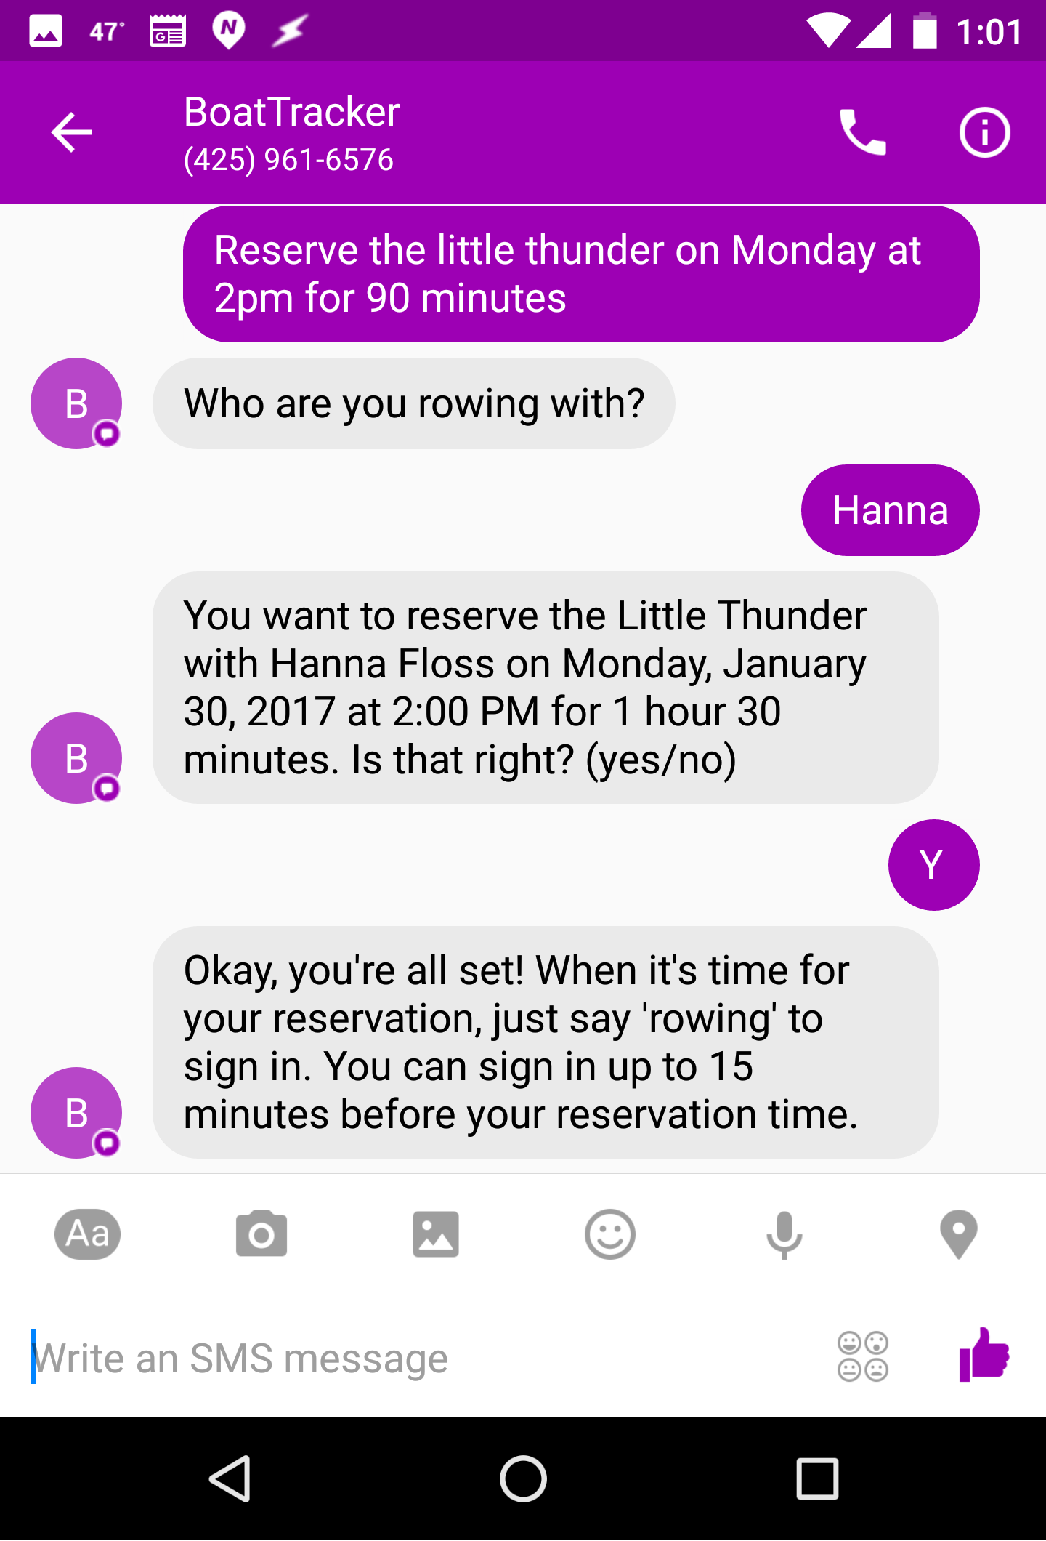
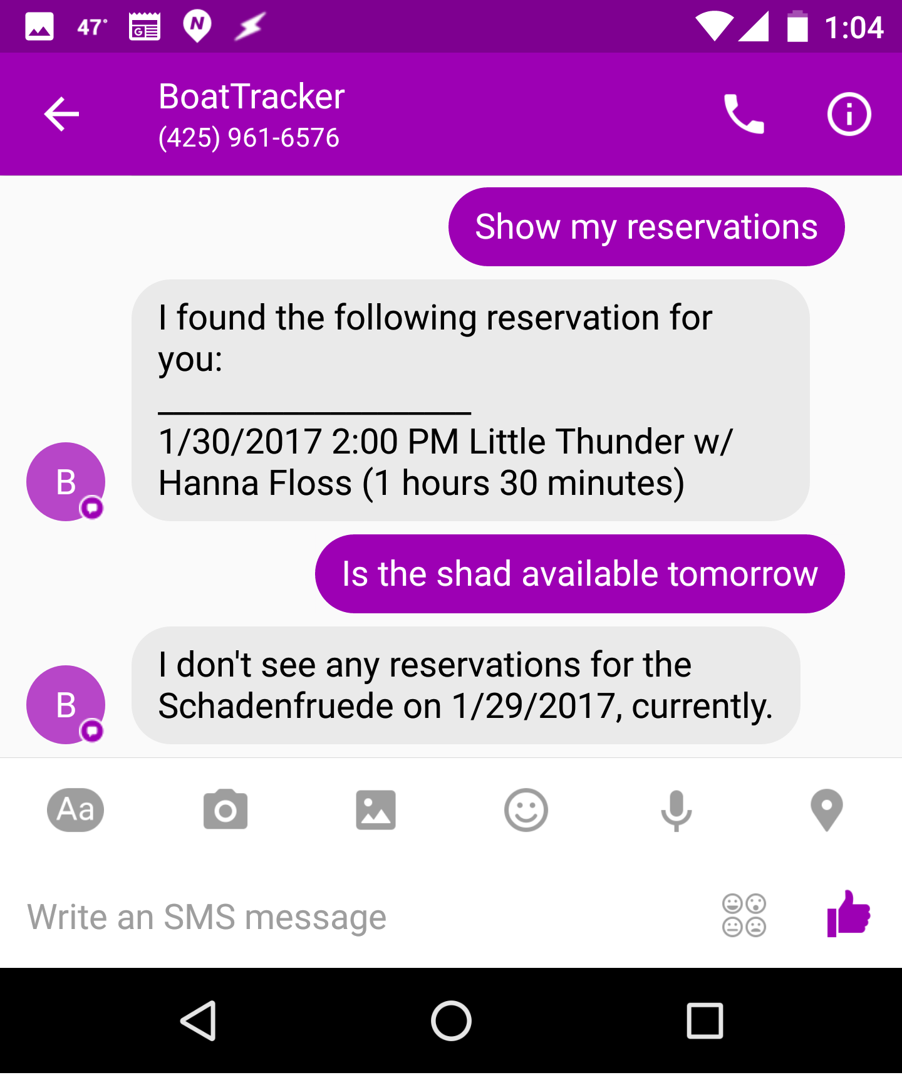
First-time use (once only)
Check in and go
Make a reservation
Check reservations or availability

